Slide 1
All Pairs Shortest Path Problem
Mohammad Shahid Qureshi

Slide 2
All pairs shortest path
The problem: find the shortest path between every pair of vertices of a graph
The graph may contain negative edges
A representation: a weight matrix where
W(i,j)=0 if i=j.
W(i,j)=∞ if there is no edge between i and j.
W(i,j)=“weight of edge”

Slide 3
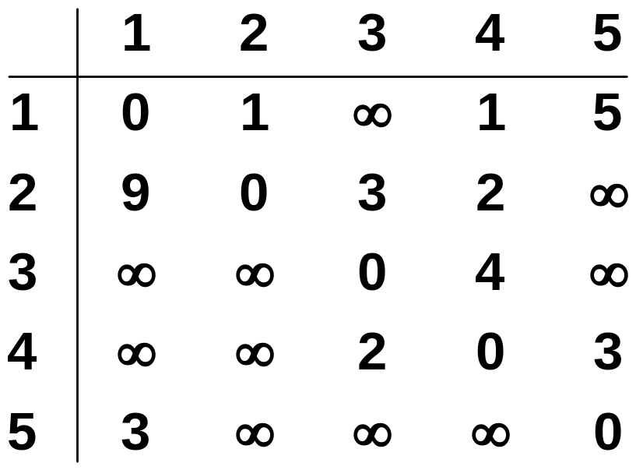
The weight matrix and the graph
1
3
v₁
v₂
9
5
1
2
3
v₅
3
2
v₄
v₃
4

Slide 4
Solution
Dijkstra’s Algorithm can be used.
  How?
  Set each vertex as source and call Dijkstra’s algo
But we can solve the problem using direct approach (Algorithm By Floyd)

Slide 5
Floyd’s Algo
Assume vertices are numbered as 1,2,3…n for simplicity
Uses n×n matrix D (n is the number of vertices in the graph G)
Shortest paths are computed in matrix D
After running the algorithm D[i,j] contains the shortest distance (cost) between vertices i and j

Slide 6
Floyd’s Algo
Initially we set D[i,j]=W[i,j]
Remember
  W[i,j] = 0 if i==j
  W(i,j) = ∞ if there is no edge between i and j
  W(i,j) = “weight of edge”
We make n iteration over matrix D
After kth iteration D[i,j] will store the value of minimum weight path from vertex i to vertex j that does not pass through a vertex numbered higher than k

Slide 7
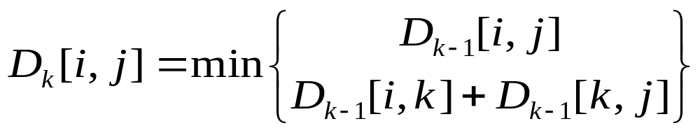
Floyd’s Algo
In kth iteration we use following formula to compute D
Subscript k denotes the value of matrix D after the kth iteration (It should not be assumed that there are n different matrices of size n×n)

Slide 8
V_{k}
V_{j}
V_{i}

Slide 9
Floyd's Algorithm
Floyd
1. D ← W // initialize D array to W [ ]
2.
3. for k ← 1 to n
4. do for i ← 1 to n
5. do for j ← 1 to n
6. if (D[ i, j ] > D[ i, k ] + D[ k, j ] ) then
7. D[ i, j ] ← D[ i, k ] + D[ k, j ]

Slide 10
Recovering Paths
Use another matrix P
P[i,j] hold the vertex k that led Floyd to find the smallest value of D[i,j]
If P[i,j]=0 there is no intermediate edge involved, shortest path is direct edge between i and j
So modified version of Floyd is given

Slide 11
Recovering Paths
Floyd
1. D ← W // initialize D array to W [ ]
2. P ← 0
3. for k ← 1 to n
4. do for i ← 1 to n
5. do for j ← 1 to n
6. if (D[ i, j ] > D[ i, k ] + D[ k, j ] ) then
7. D[ i, j ] ← D[ i, k ] + D[ k, j ]
8. P [ i, j] ← k

Slide 12
Example
1
2
3
1
0
4
5
W = D⁰ =
1
2
2
0
∝
5
3
∝
-3
0
4
2
3
1
2
3
2
-3
1
0
1
1
P =
2
2
0
0
3
0
3
0

Slide 13
1
2
3
1
5
D⁰ =
1
0
4
5
4
2
3
2
2
0
∝
2
-3
3
∝
-3
0
1
2
3
1
0
4
5
D¹[2,3] = min( D⁰[2,3], D⁰[2,1]+D⁰[1,3] )
= min (∝, 7)
= 7
D¹[3,2] = min( D⁰[3,2], D⁰[3,1]+D⁰[1,2] )
= min (-3,∝)
= -3
D¹ =
2
2
0
7
3
∝
-3
0
1
2
3
1
0
1
1
P =
2
2
0
1
3
0
3
0

Slide 14
k = 2
Vertices 1, 2 can be intermediate
1
2
3
1
5
D¹ =
1
0
4
5
4
2
3
2
2
0
7
2
-3
3
∝
-3
0
1
2
3
1
0
4
5
D²[1,3] = min( D¹[1,3], D¹[1,2]+D¹[2,3] )
= min (5, 4+7)
= 5
D²[3,1] = min( D¹[3,1], D¹[3,2]+D¹[2,1] )
= min (∝, -3+2)
= -1
D² =
2
2
0
7
3
-1
-3
0
1
2
3
1
0
1
1
P =
2
2
0
1
3
2
3
0

Slide 15
k = 3
Vertices 1, 2, 3 can be intermediate
D² =
1
2
3
1
5
1
0
4
5
4
2
3
2
2
0
7
2
-3
3
-1
-3
0
1
2
3
1
0
2
5
D³ =
D³[1,2] = min(D²[1,2], D²[1,3]+D²[3,2] )
= min (4, 5+(-3))
= 2
D³[2,1] = min(D²[2,1], D²[2,3]+D²[3,1] )
= min (2, 7+ (-1))
= 2
2
2
0
7
3
-1
-3
0
1
2
3
1
0
3
1
P =
2
2
0
1
3
2
3
0

Slide 16
